Slide 1
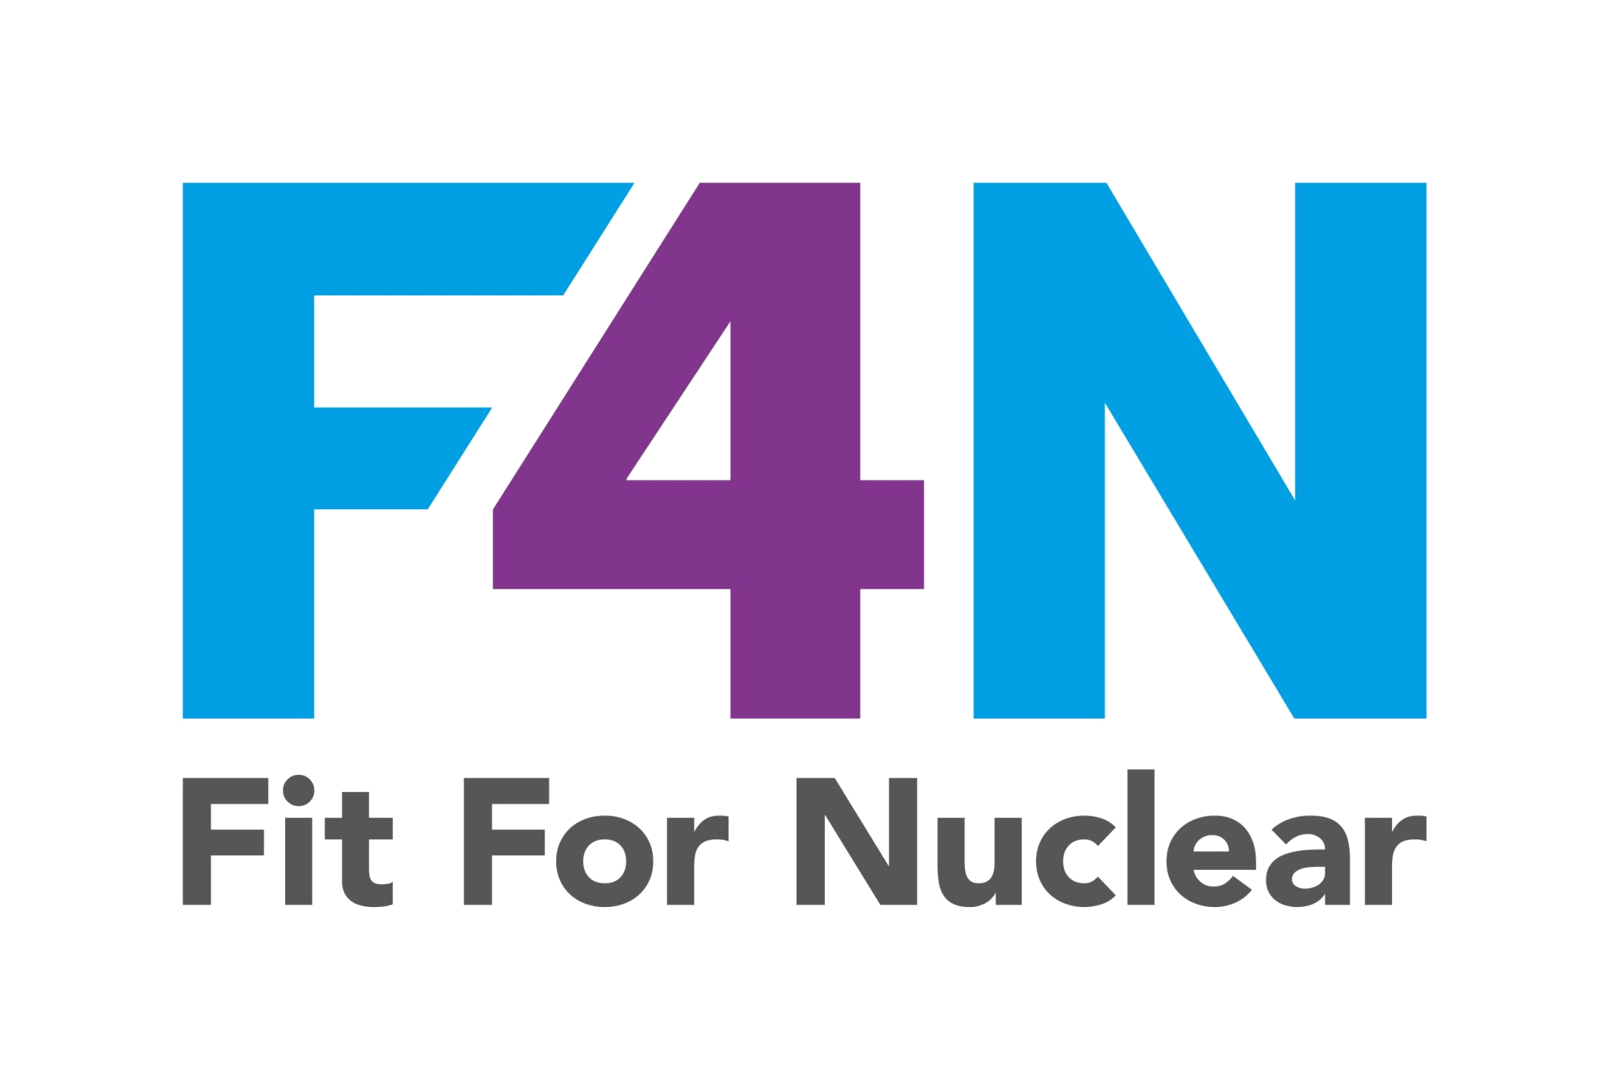


OUR NUCLEAR SAFETY CULTURE COMMITMENT
The ten traits we are committed to, every day
INDIVIDUAL COMMITMENT TO SAFETY
MANAGEMENT COMMITMENT TO SAFETY
MANAGEMENT SYSTEMS
IR
LR
CL
Individual
Responsibility
Leader
Responsibility
Continuous
Learning
QA
DM
PI
Questioning
Attitude
Decision-
Making
Problem ID
& Resolution
CO
WE
RC
Communication
Work
Environment
Raising
Concerns
WP
Work
Planning
NucCol | Nuclear Collaboration Ltd · Fit For Nuclear Programme · Commercial in Confidence | 1

Slide 2
OUR COMMITMENT TO NUCLEAR SAFETY CULTURE
As an organisation working in the nuclear supply chain, we commit to:
1
Every individual takes personal responsibility for nuclear safety in their own work, every day
2
We maintain a questioning attitude and never assume past success means future safety
3
Our leaders are visibly present, model safe behaviour, and act on what they hear and see
4
Decisions involving risk are systematic, conservative, and clearly owned
5
We treat every individual with trust and respect, and welcome differing views
6
We learn continuously, from our own experience and from across the wider industry
7
Problems, however small, are identified, reported, and properly resolved
8
Anyone can raise a safety concern, in confidence if needed, without fear of retaliation
NucCol | Nuclear Collaboration Ltd · Fit For Nuclear Programme · Commercial in Confidence | 2

